Slide 1


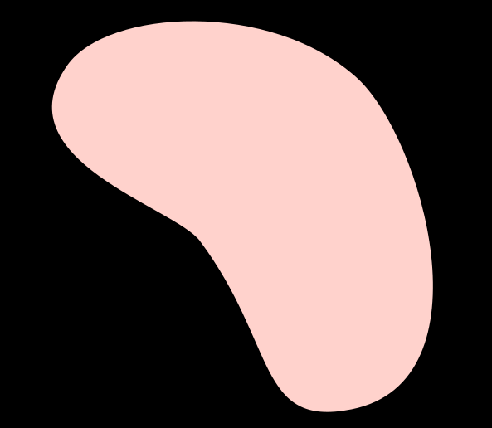
Peddineni Rupesh chowdary
-S20210010173
THREE CARD POKER
A Smart Contract based game......
Github Link :
https://github.com/Rupesh2728/BTA-Project.git
Deployment Link :
https://threecardpoker.vercel.app/

Slide 2

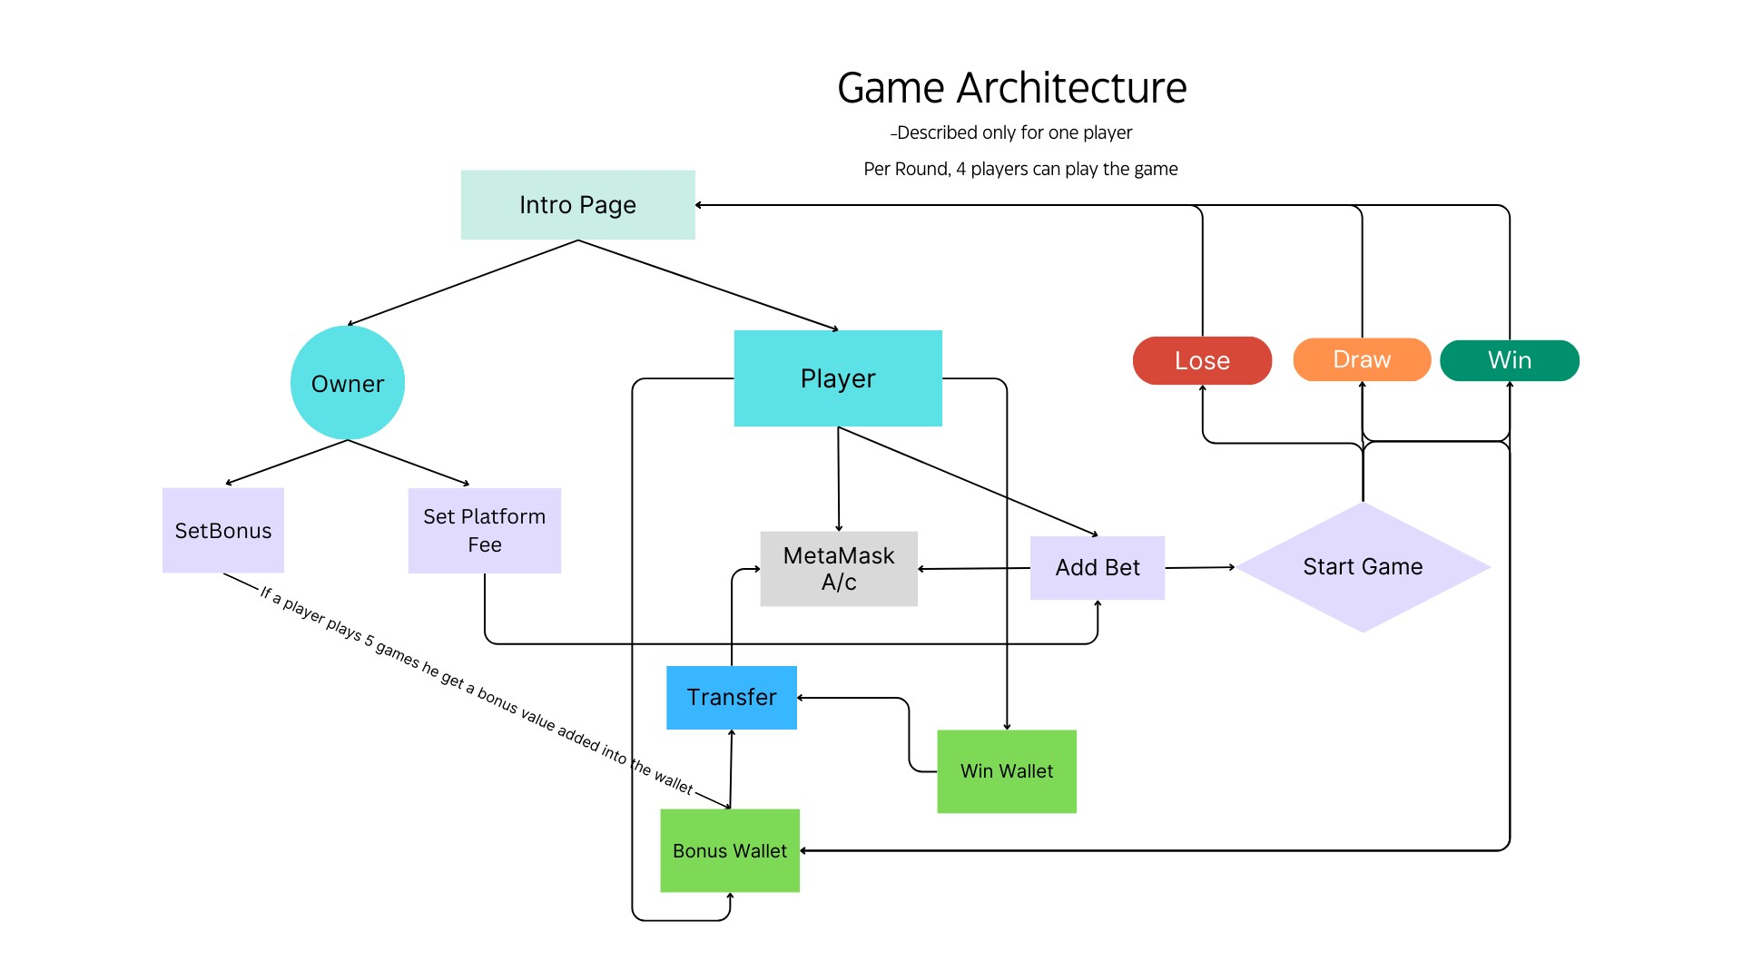

ARCHTECTURE AND TECH STACK
EthersJs
Hardhat
Sepolia testnet
Solidity
Metamask
ReactJs
TailwindCSS

Slide 3


FEATURES IMPLEMENTED
Features | Implemented (Yes/No)
Meta-mask Integration | Yes
Platform Fee | Yes
Player Fee | Yes
Bonus | Yes
Seperate Dashboard’s | Yes

Slide 4



The pleasure of engaging with an aesthetically pleasing user interface enhances the overall gaming experience.
UNIQUENESS
Winning Algorithm is quite simple and different from the existing one
A bonus awarded to the player for every 5 games played serves as a source of satisfaction, enhancing their gaming experience with my game.
Created separate dashboards for both players and Owner
Each round accommodates four players, ensuring that gameplay proceeds without interruption from individuals not engaged in the game. However, it is worth noting that the current setup may not be highly scalable, but potential improvements can be implemented by adjusting the smart contract.

Slide 5


THANK YOU !
Regards-
P. Rupesh chowdary
S20210010173

